Slide 1

BANK ANALYSIS PROJECT
Group Members:-
Razat Shubham
Biswajit Sahoo
Bhagyashri Dubey
Rekha M
Zeeshan Rizwan

Slide 2
Aim for this Presentation is to discover some insights by using visualization
1. Preparation
2. Overview
3. KPI’s
4. Dashboard

Slide 3
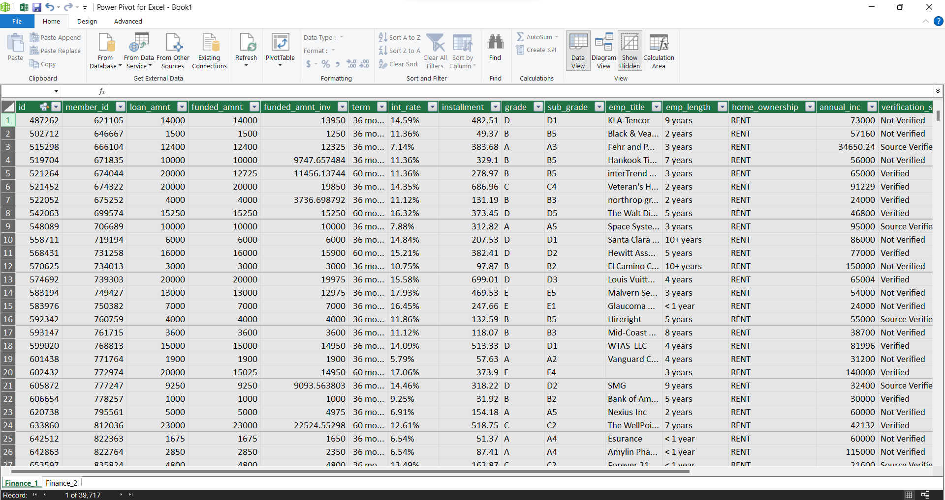
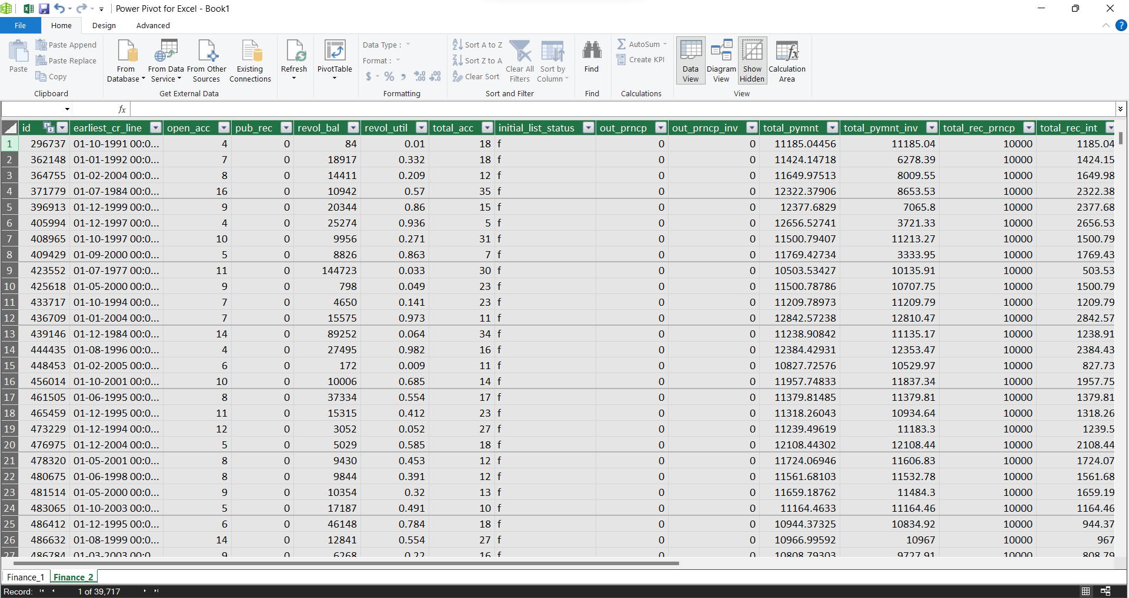
Preparation
We have established connection between 2 files and removes some of the columns which contains more than 30% null and blank values.
Table-1
Table-2

Slide 4

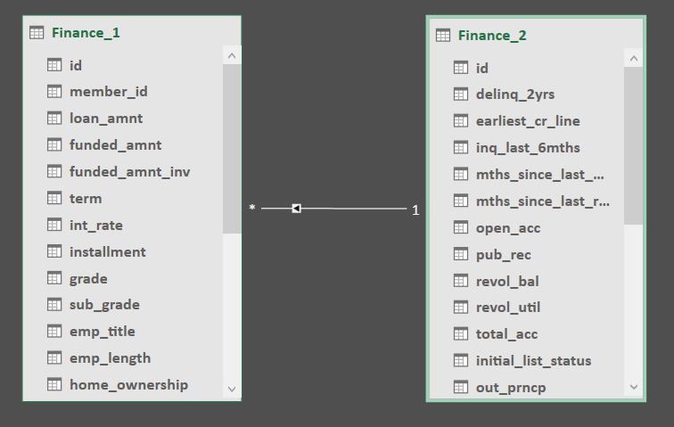



Explore Dataset and perform Data Validation
Data Cleaning
Data Modeling
Share Insights

Slide 5
OVERVIEW
INTRODUCTION
In response to the evolving of the financial industry, this bank analysis project has been initiated to comprehensively assess the operations, performance, and financial health of the Banks. Understanding the critical role that banks play in economic stability, this analysis aims to provide valuable insights for informed decision-making and strategic planning.
OBJECTIVE
We're checking out to see how well it's doing with money, what things could go wrong, and how smoothly everything is running. We want to find out where the bank is good and where it can do better. This way, we can handle problems well and help the bank do even better overall.
SCOPE
We're looking closely at things like loan Amount, Profit earn by the bank, Loss of the bank in this project. But it's important to know that we might not be able to check everything because some things, like not having all the needed information and outside factors, might limit what we can study.
CONCLUSION
In summary, our project checking out Bank is set to give a good, detailed look at how the bank is doing with its money. The results will help the bank plan for the future, manage risks, and make smart decisions. Plus, it adds to what we know about banks in our ever-changing economy.

Slide 6





KPI’S
State and last credit pull date wise loan status
Grade and Sub-grade wise revolving balance
Verification wise Total Payment
Year wise loan amount Stats
Home ownership Vs last payment date stats

Slide 7

INTERPRETATION NOTE BOOK

Slide 8

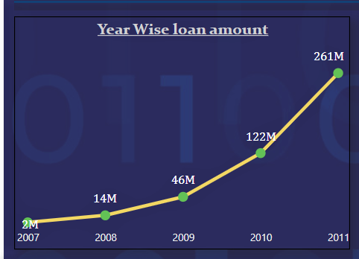
INTERPRETATION:-
Looking at the data from 2007 to 2011, we can see that the amount of loans given each year went up a lot. It started at 2 million dollars in 2007 and kept increasing: 14 million in 2008, 46 million in 2009, 122 million in 2010, and the highest at 261 million in 2011. This tells us that more and more money was being borrowed each year during this time. Understanding these trends helps people make smart decisions about money and loans for the future.
KPI - 1
PAGE 03

Slide 9
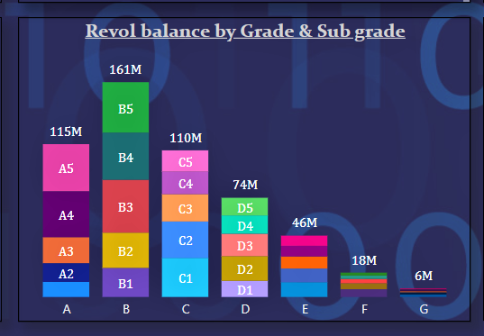
INTERPRETATION:-
The data shows how much money people owe based on their credit grades (A, B, C, D, E, F, G) and sub-grades (1 to 5). Altogether, the total owed is 532 million. Looking at the information, it seems that higher-grade categories tend to have more owed money which is the grade B and the lowest grade is G. This data is useful for banks and lenders to understand the risk of lending money and to make decisions about revol_bal. It gives a clear picture of how much people owe in different grades, helping them manage the risk of lending money.
KPI - 2
PAGE 05

Slide 10
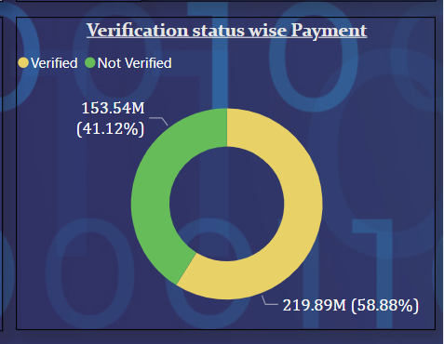
INTERPRETATION:-
To sum it up, when we look at all the payments
made, those with a "verified" status add up to
219.89 million, while those without verification
total 153.54 million. This means that verified
payments are higher than non-verified ones.
This information suggests that making sure
transactions are verified might be important for
handling more payments. Businesses and banks
could use this data to see how verifying
transactions could impact the overall amount of money being exchanged.
KPI - 3
PAGE 07

Slide 11
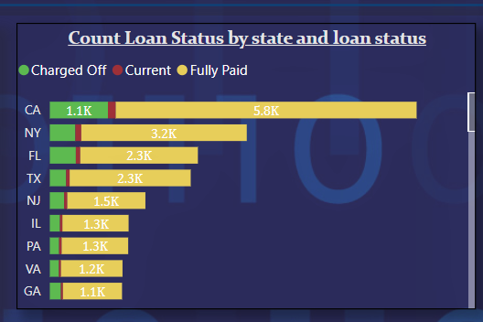
INTERPRETATION:-
Fully Paid had the highest total Count Loan
Status at 32950, followed by Charged Off
at 5627 and Current at 1140.﻿ ﻿﻿CA in loan
status made up 14.66% of Count Loan Status .﻿﻿
﻿﻿Fully Paid had the highest average Count
Loan Status at 659.00, followed by Charged
Off at 119.72 and Current at 26.51.﻿﻿
KPI - 4
PAGE 09

Slide 12
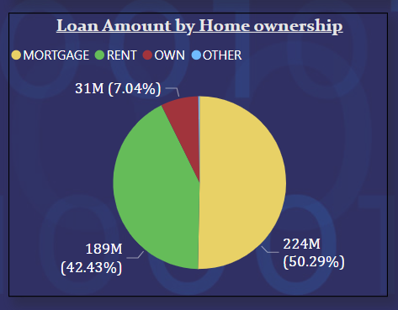
INTERPRETATION:-
Count for each last payment date broken
down by Home Ownership.
RENT accounted for 47.58% followed
by Mortgage by 44.46% of Count of home
ownership.
KPI - 5
PAGE 11

Slide 14
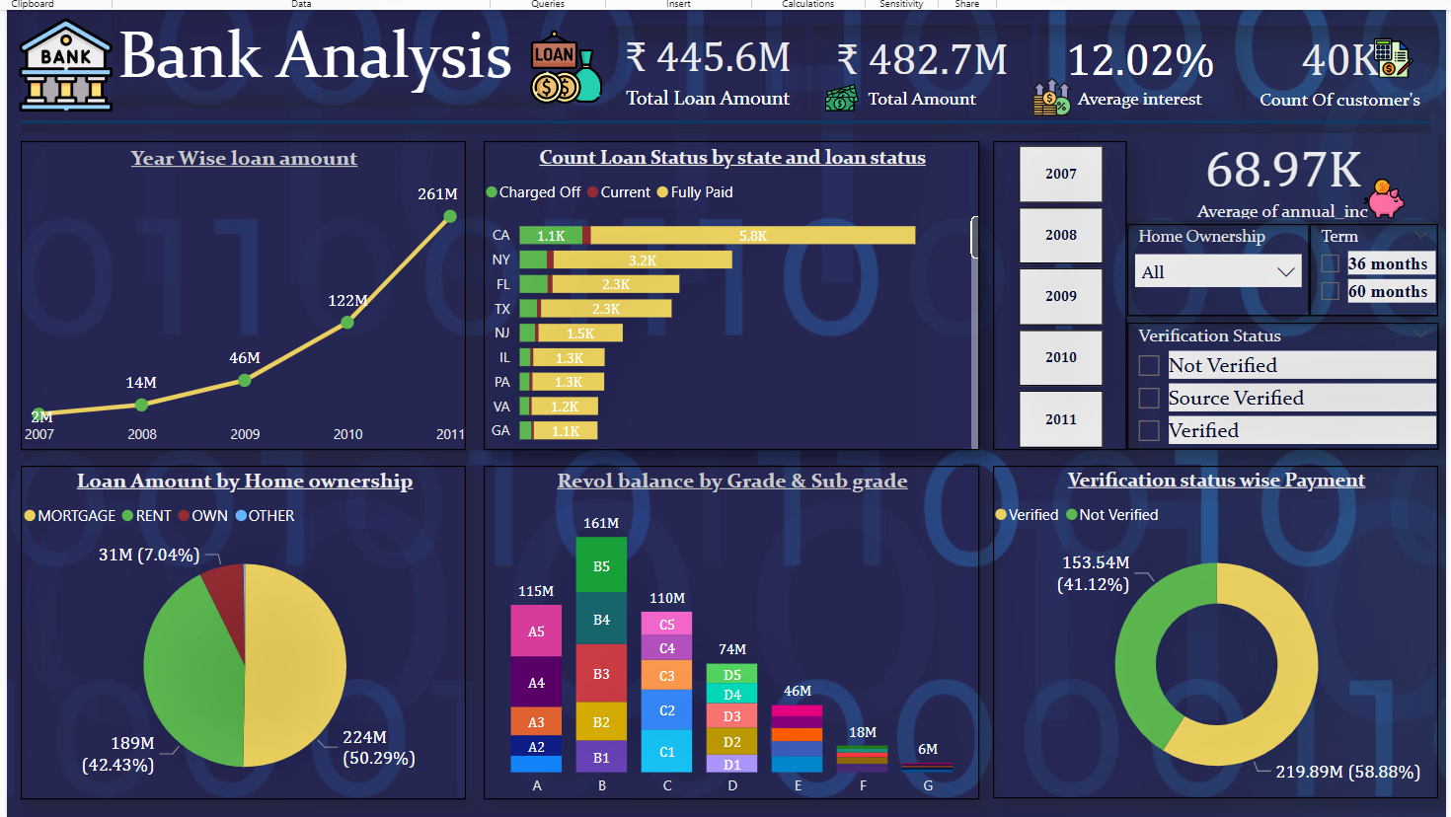

Slide 15
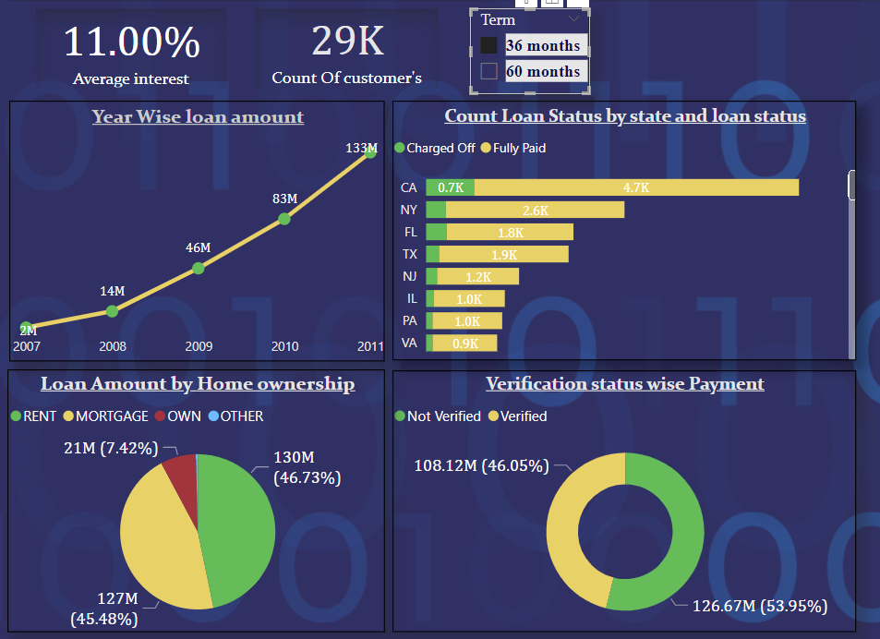
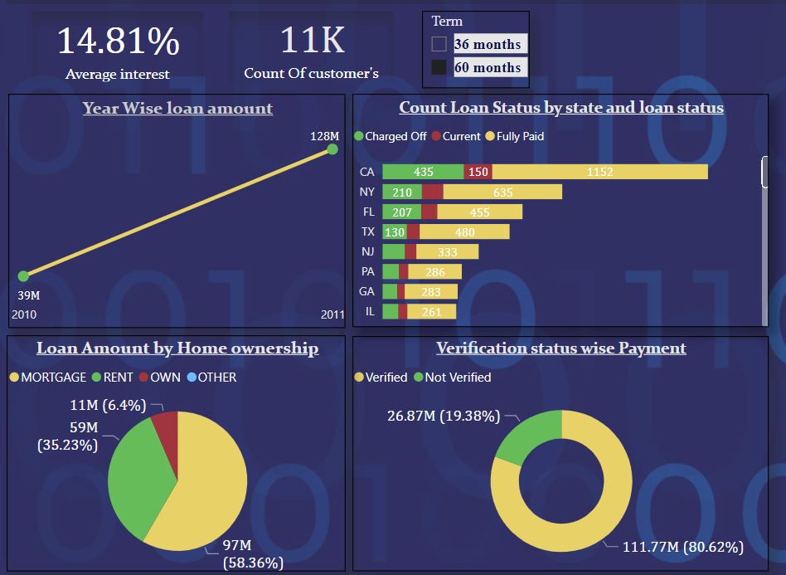
We have customers from 2007 – 2011 in 36month policy but in the 60 month term policy customers joined recently and in 2011 the value of loan amount nearly came to equal.
In 36 month plan around 127M of payments are not verified.
No. of customers are less in the 60month term policy than the other one .
Rented persons are not willing for the 60months plan .
Most importantly all the 36months loan plans already completed the only ongoing plan is 60month plans .

Slide 16
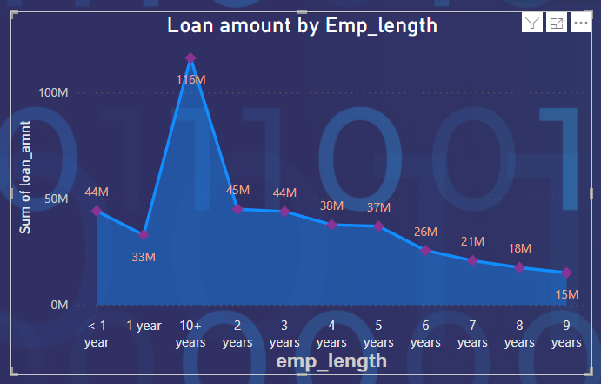
Loan According to Employment length
From the KPI we came to know which type of employee are mainly our customers.
Mainly at first 3 Year of employment people apply for loan then its gradually decreasing then after 10 years of employment most people again applying for loan
There is downfall after 3 years of employment.

Slide 17
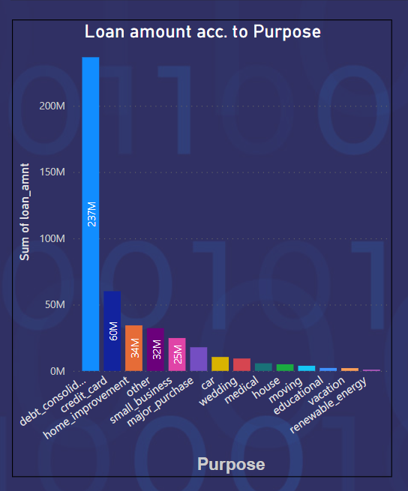
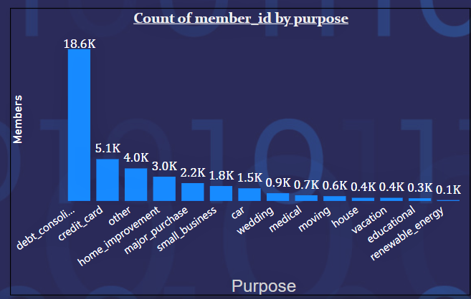
Purpose Wise Loan
After debt consolidation most people are paying for credit card then home improvement and for small business . We have to look why peoples are not that much interest in car, house and educational loan
From charts we can clearly put a point that we have very less customers in car , house and educational loan .
But very very less customers for renewable energy we should encourage people.

Slide 18

THANK YOU

